Slide 1
RAKSHA Alert (Intruder detector system)

Slide 2




Team name (VIGILANT DETECTOR)
IBM Mentor
Mr. NAVEEN PRATHAPANENI
Edunet Mentor
Mr. DEEPNEEL MAJUMDAR
Team Members
Subhashree Agrawal
Uzma Usmani
Suman Kr Mishra
Avijit Dutta

Slide 3
Workload Division
Contribution of each team member in project
Subhashree Agrawal: Feature Implementation
Uzma Usmani: Documentation & Coding Support
Suman Kumar Mishra: Chatbot Deployment
Avijit Dutta: Website Designing

Slide 4
The Background
Over the years, home security systems have evolved from simple alarm-based systems to advanced video surveillance.
Traditional systems lacked real-time alerts and comprehensive detection capabilities.

Slide 5
Problem Statement
With rising safety concerns for families, especially with children, women, and the elderly left alone at home, there is a growing need for home security systems that offer real-time monitoring and interactive emergency alerts.
Current solutions lack personalized responses to unauthorized entries and compromising security.

Slide 6
Proposed Solution
Raksha Alert is a unified security system which detects:
Both known and unknown individuals,
Sends detailed alerts with images and location,
Detects objects threats, Voice-activated emergency response,
Real-time insights with OpenAI and Llama2 integration with chatbot.
Addresses gaps in current solutions by providing a comprehensive security platform.

Slide 7
Solution Design
Face Detection
Known Person
Unknown Person
Danger
Not in Danger
Alert by Voice Commands
Police
Neighbor
Alert members with Image & Geolocation
Start
End
Object
Detection
Hazardous objects
Non-hazardous objects
Alert by Alarm

Slide 8
Technology Stack & Requirements
Pre-trained model:
DeepFace
face_recognition
YOLOv4
Technology Used:
Python
OpenCV
Deep Learning
Cloud
Hardware Requirements:
Webcam
Server
High-speed internet

Slide 9

Innovative Idea
Advanced Integration & Detailed Alerts
Voice-Activated Emergency Response
Llama2 and OpenAI powered responsive and real-time chatbot updates.
Its user-focused approach delivers faster, more effective solutions, making it a standout in market.

Slide 10
Results / Outcomes / Analysis
Raksha Alert integrates detection, alerting, and emergency response into a unified system.
It efficiently enhances security, delivering robust protection and user’s peace of mind.

Slide 11

Limitations
Internet Dependency: Requires a stable internet connection.
Environmental Challenges: Low light affect facial recognition accuracy
False Positives: Unrecognized individuals occasionally trigger false alerts.

Slide 12

Future Enhancements/Scope
Enhanced Emotion recognition & Voice commands
Behaviour analysis
Iris and gait recognition
Data privacy with stronger encryption
IoT Integration with smart home devices
Coordinate multiple cameras for better coverage
Mobile App

Slide 13
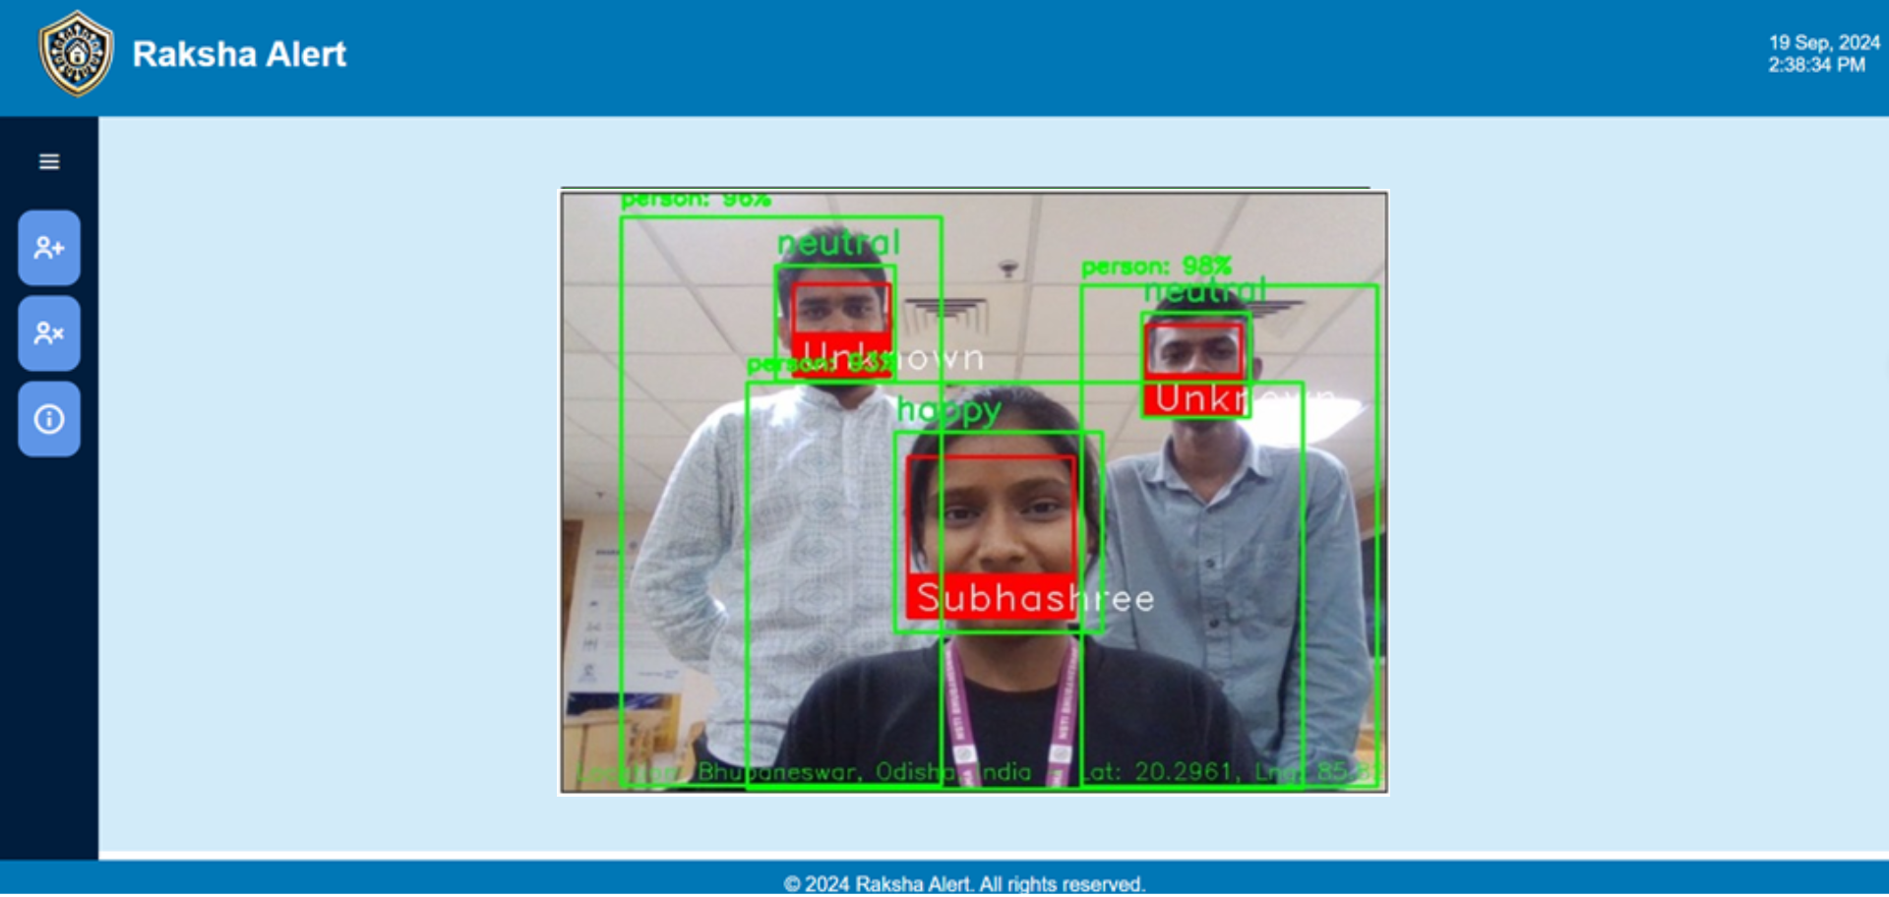

Slide 14
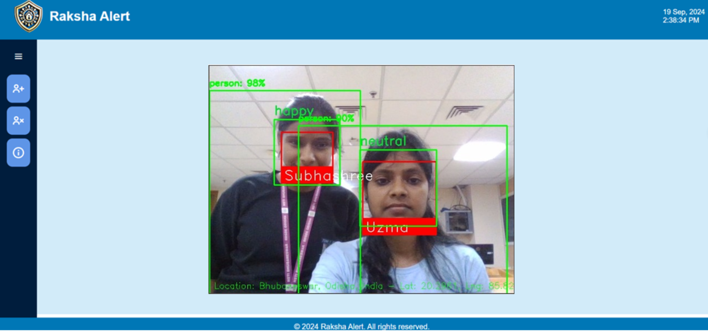

Slide 15
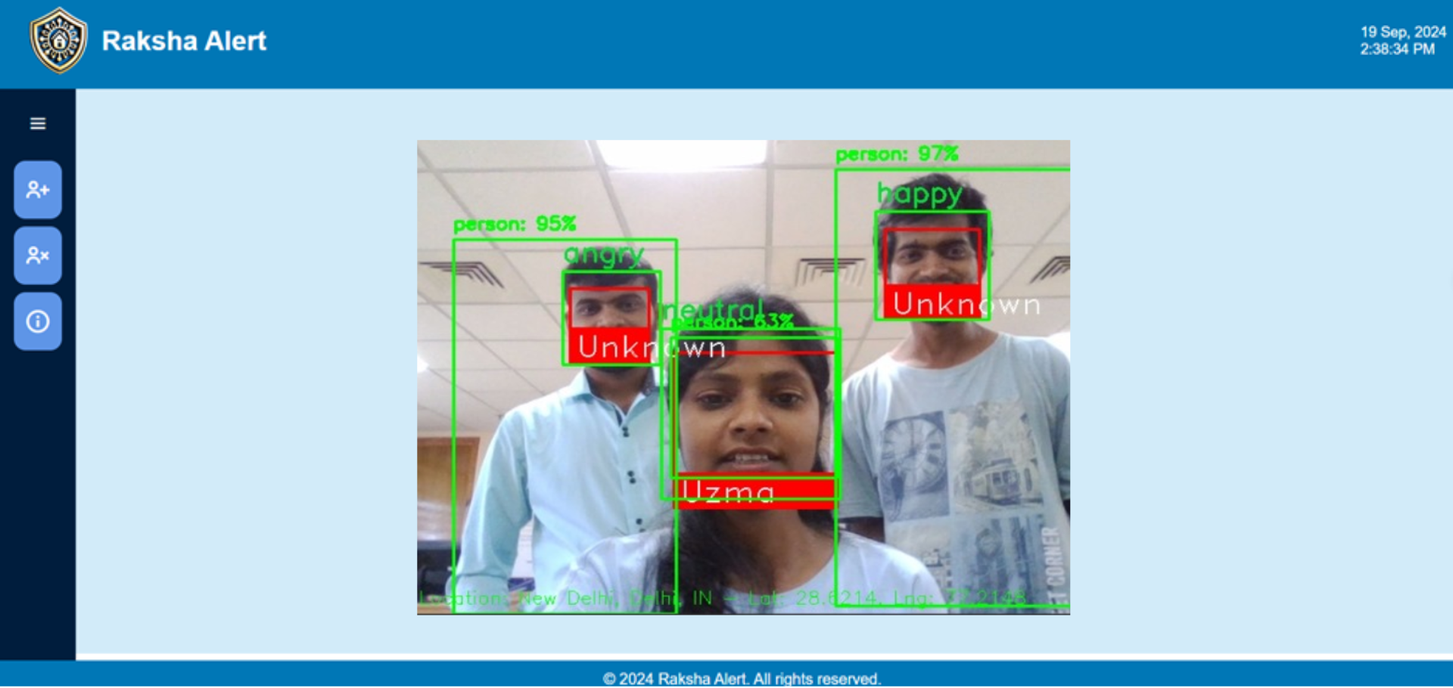

Slide 16
GitHub link
https://github.com/subhu00/projectrakshaalert.git

Slide 17
Thank You

